Slide 1

OptiMe
Just my type.

Slide 2
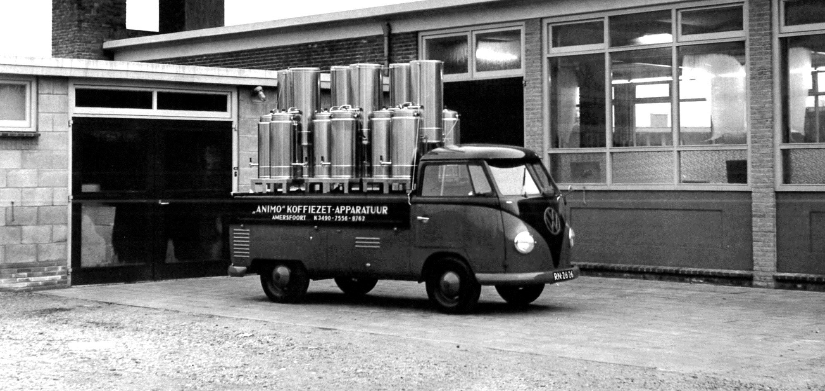
Experience, knowledge & DEDICATION

Slide 3
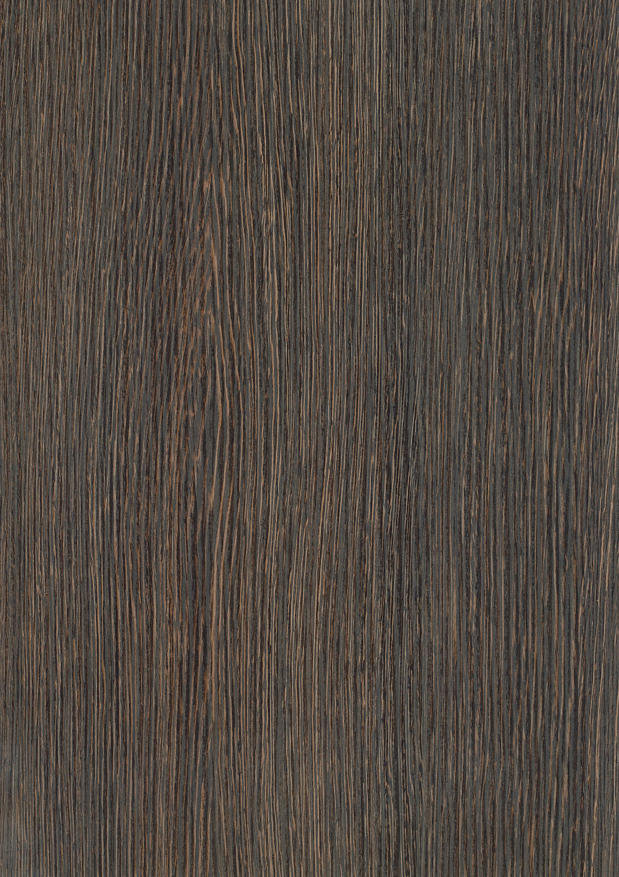

Animo stands for great coffee, award-winning designs and
genuine sustainability. We use high-quality components and a
clean production process to build energy-efficient machines with
durable performance and excellent taste.

Slide 4
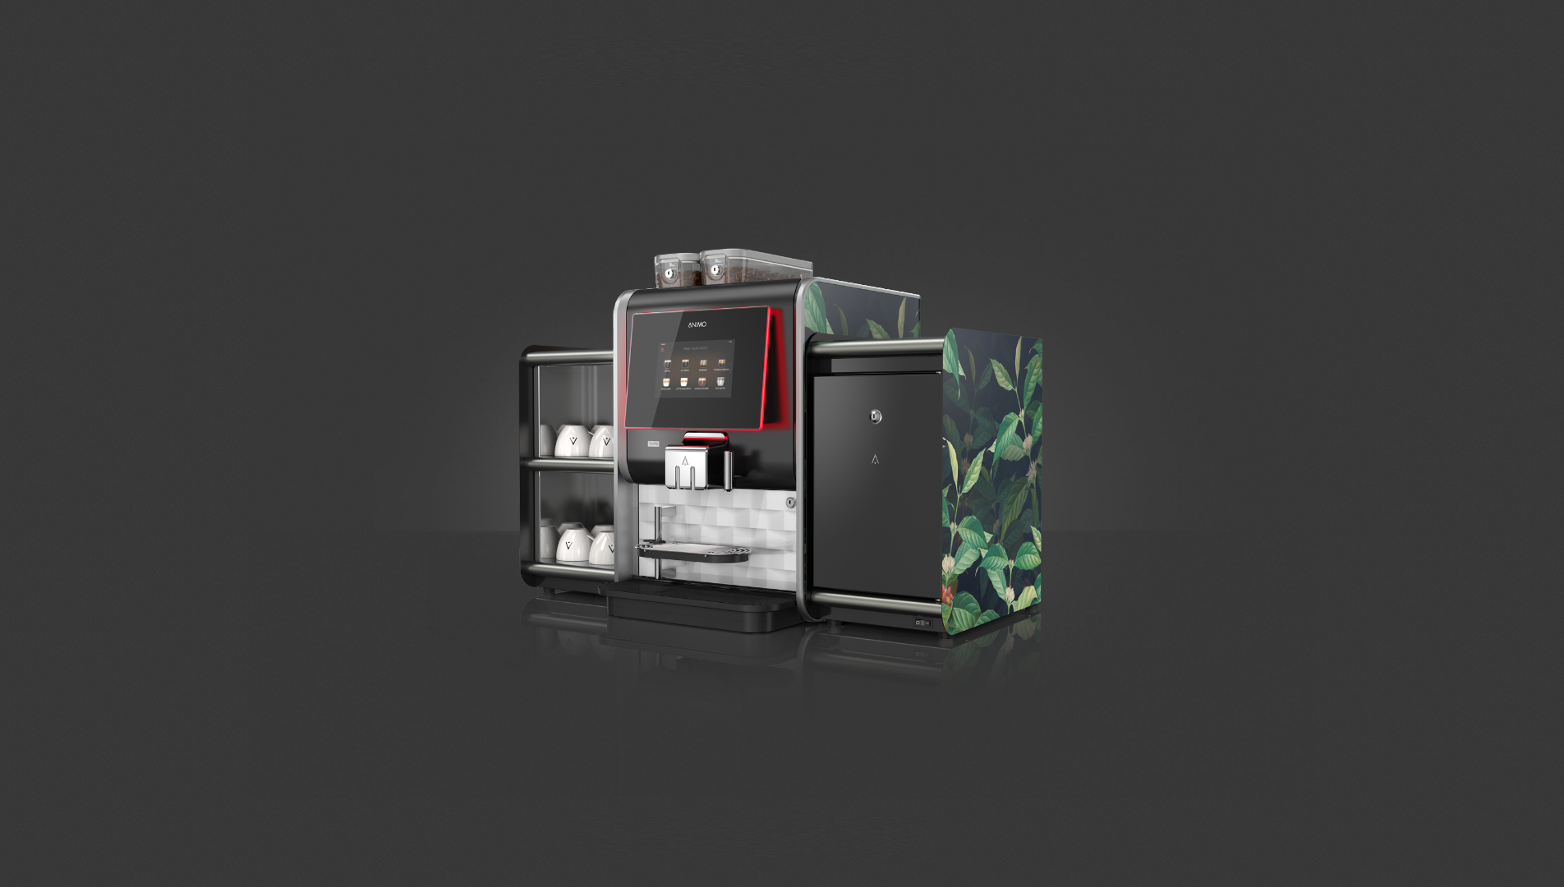
Matching your taste
Perfect coffee starts with the perfect machine. But when the machine also matches your taste, that’s when the magic happens. Get it all with Animo’s newest professional coffee machine: OptiMe.
OptiMe
Just my type.

Slide 5
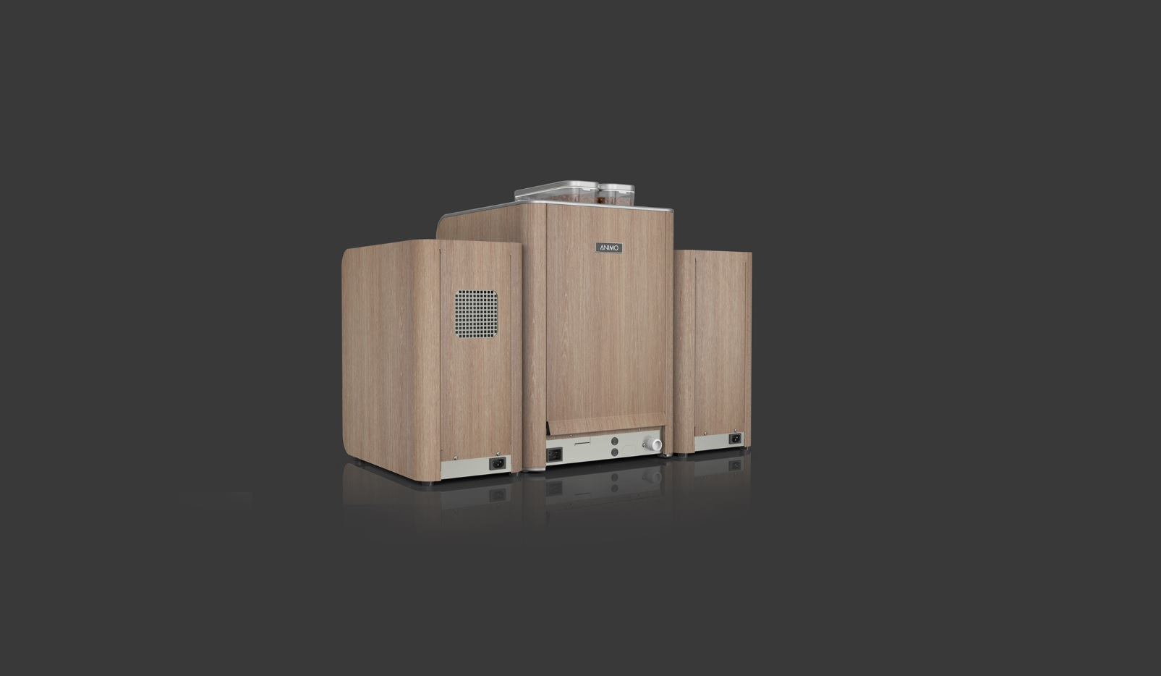
EXPRESS your STYLE
+ Compact 360° design
OptiMe
Just my type.

Slide 6
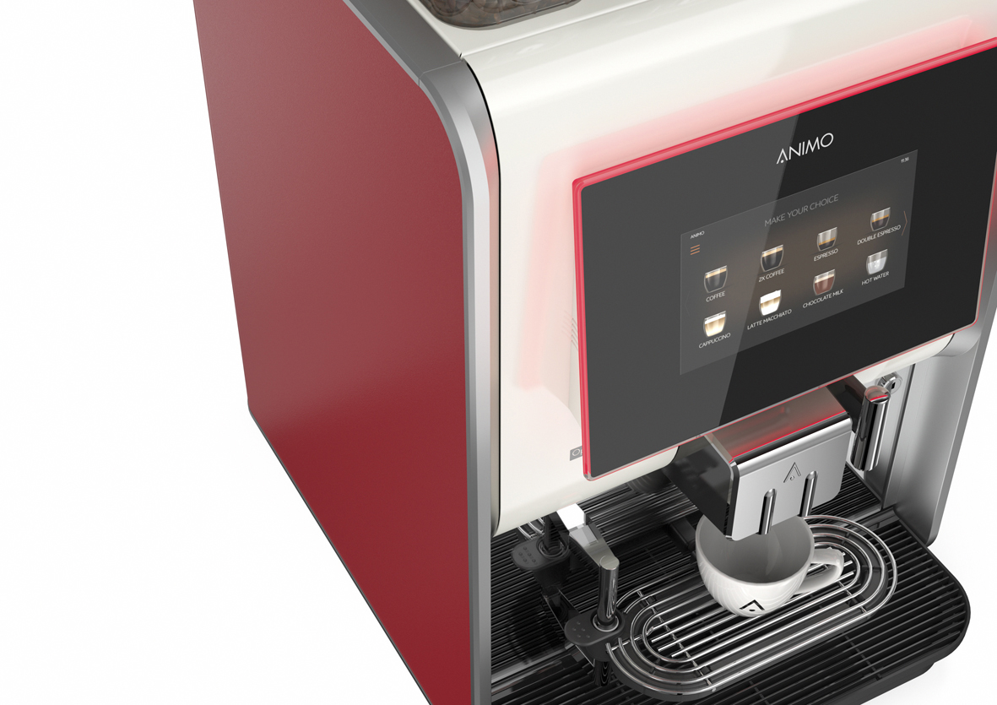
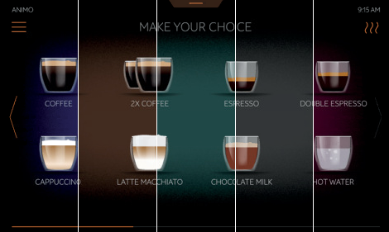
Good taste isn’t just about flavour.
+ Extensive options for (commercial) messaging on screen
+ OptiLight LED Lighting
+ Different options for the background colour of the display

Slide 7
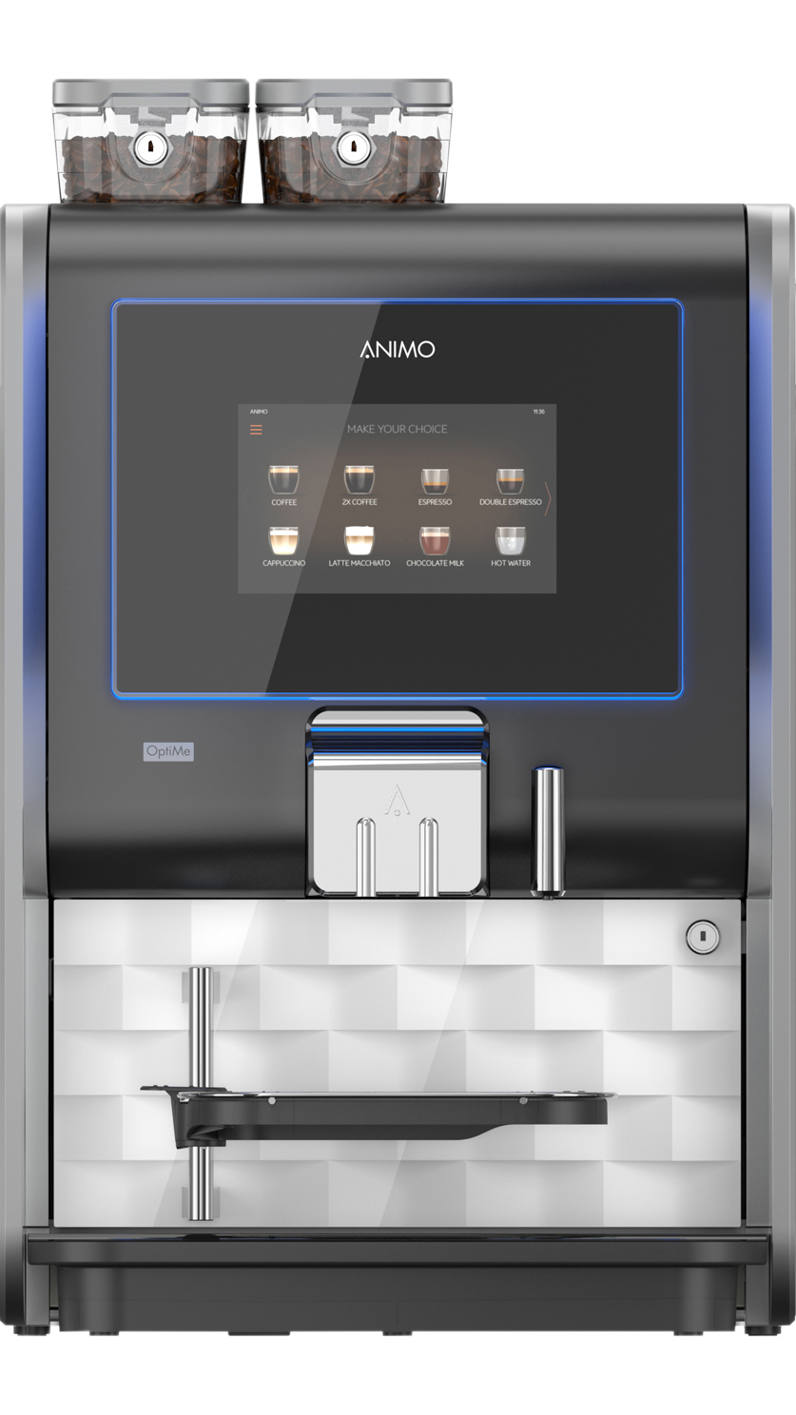
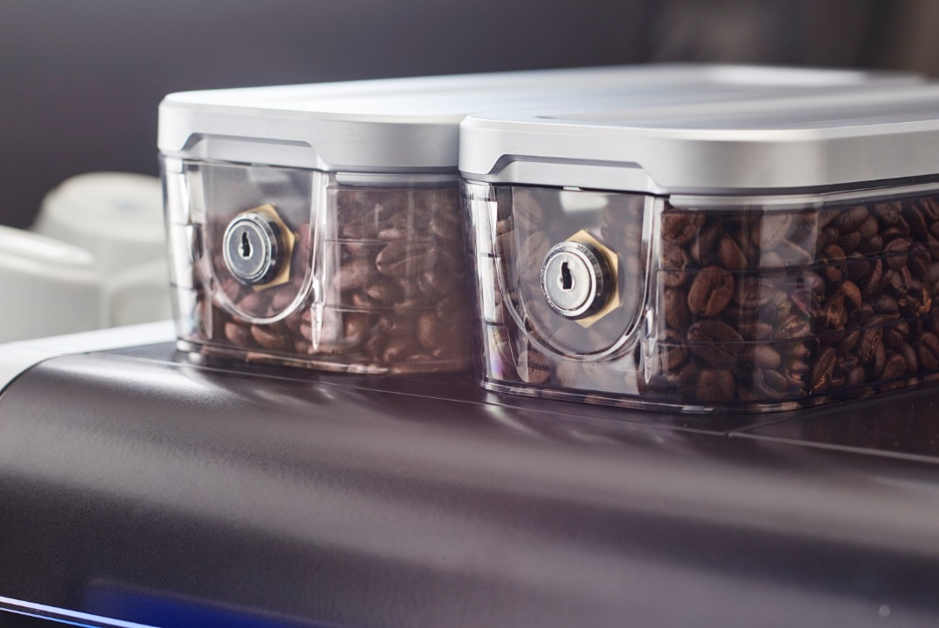
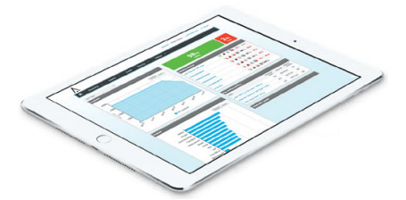
Small machine big flavour
+ Recommended daily output up to 125 cups per day
+ Choose between one or two bean canisters / grinders
+ Prepared for telemetry connection (monitor performance from distance)

Slide 8
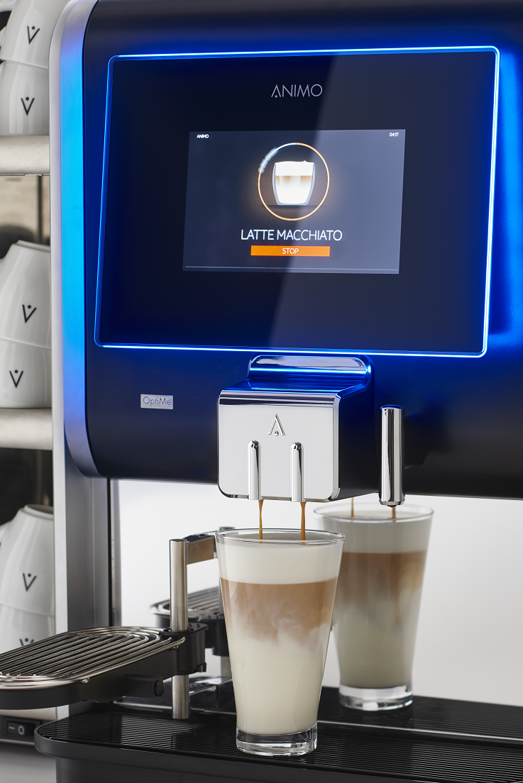
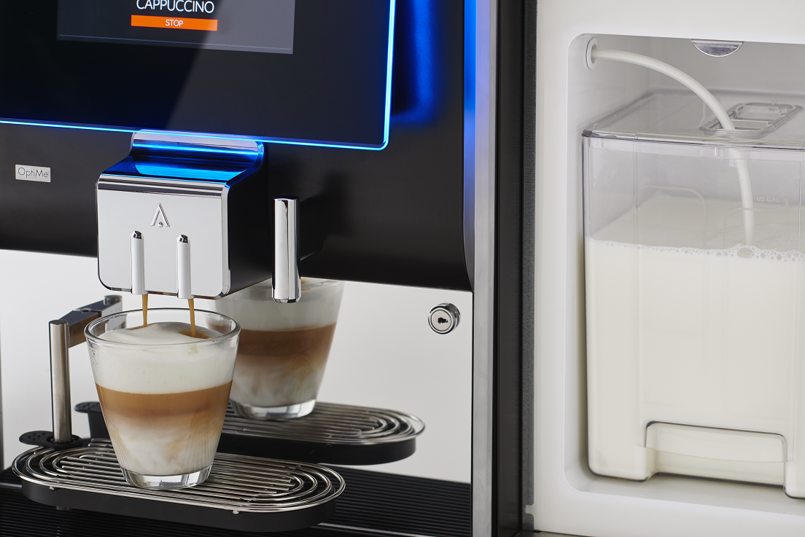

How about some FRESH MILK?
OptiMe can use fresh milk to create many varieties of espresso-based drinks, including cappuccino, latte and latte macchiato.
+ Silent in use
+ Constant quality
+ Hygiene in accordance with HACCP standards
+ Maintenance friendly with quick and easy cleaning: the user interface perfectly guides you through the cleaning processes

Slide 9
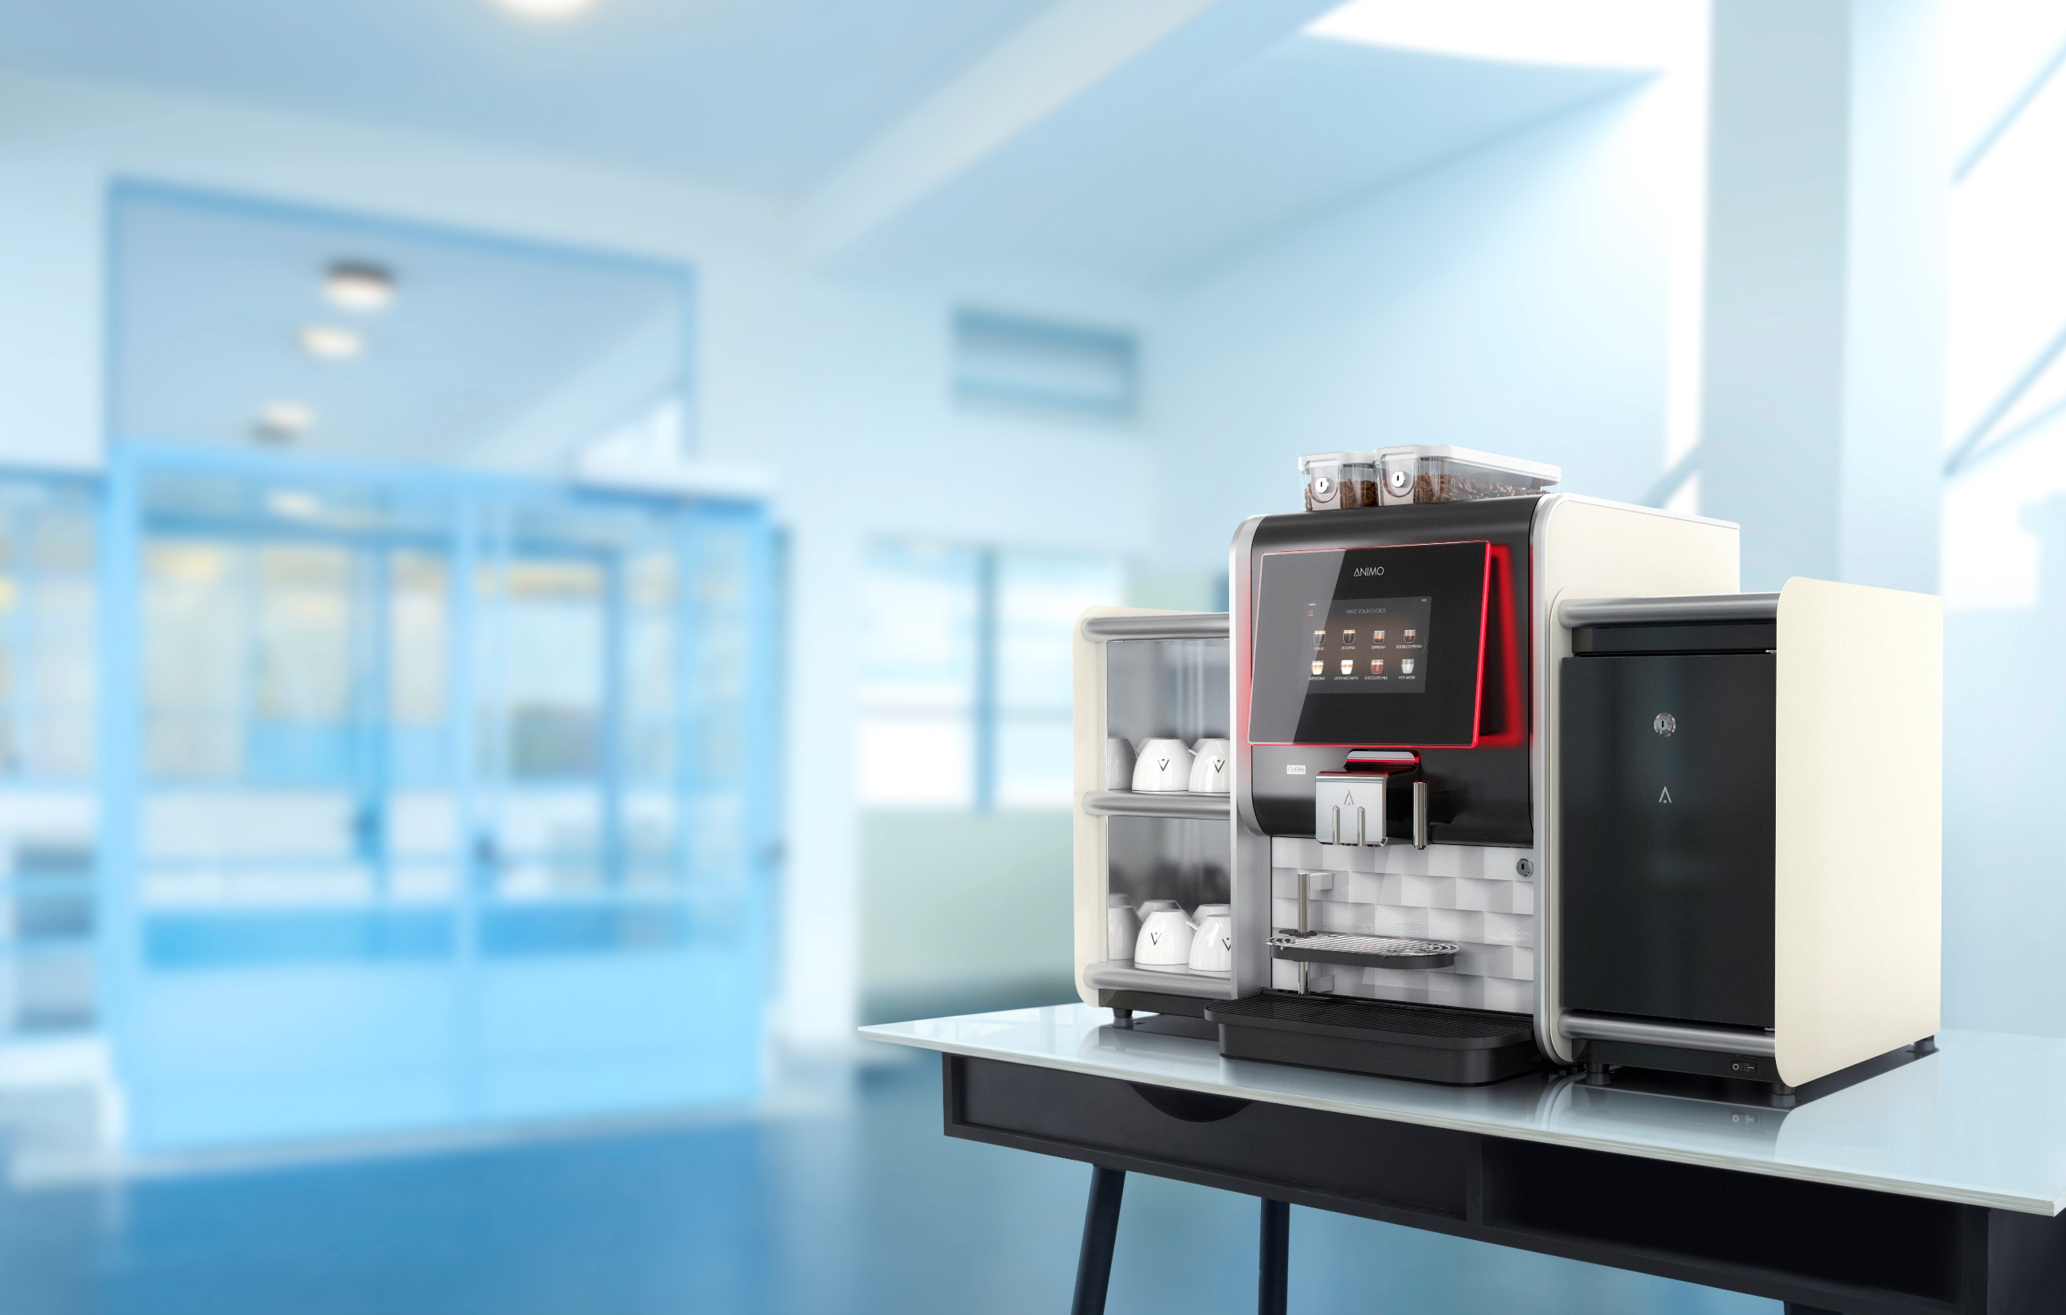
FITS EVERYWHERE

Slide 10
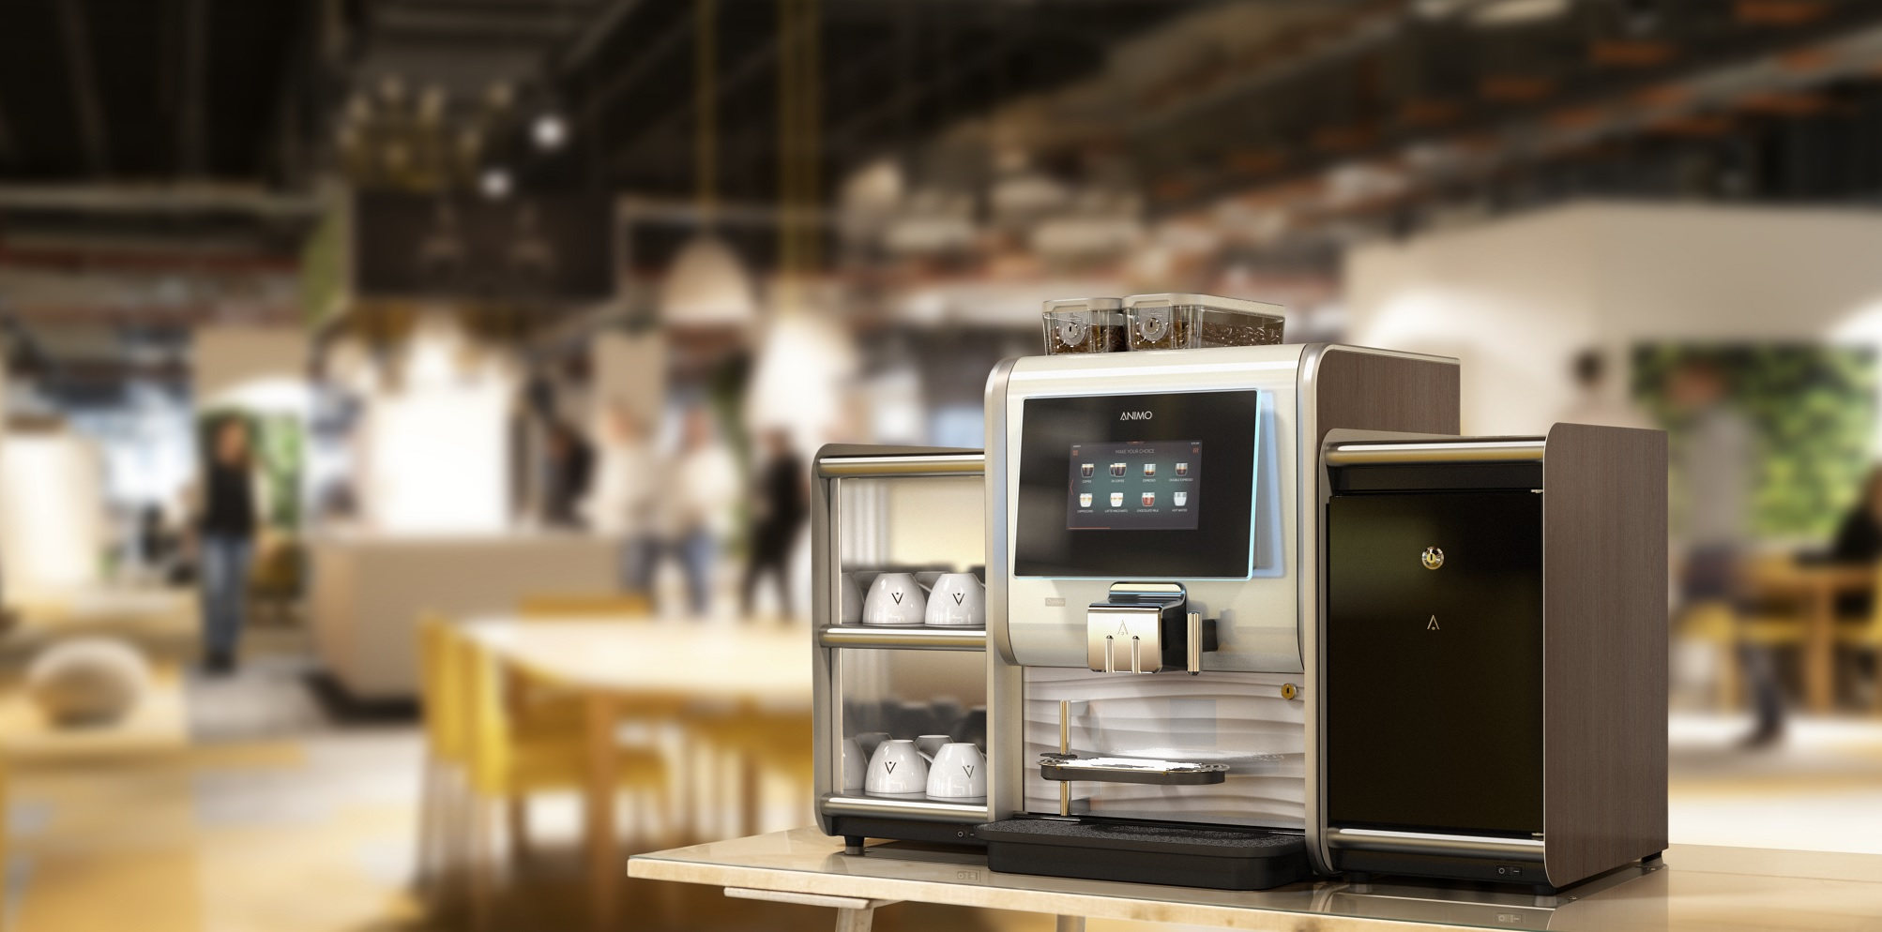
FITS EVERYWHERE

Slide 11
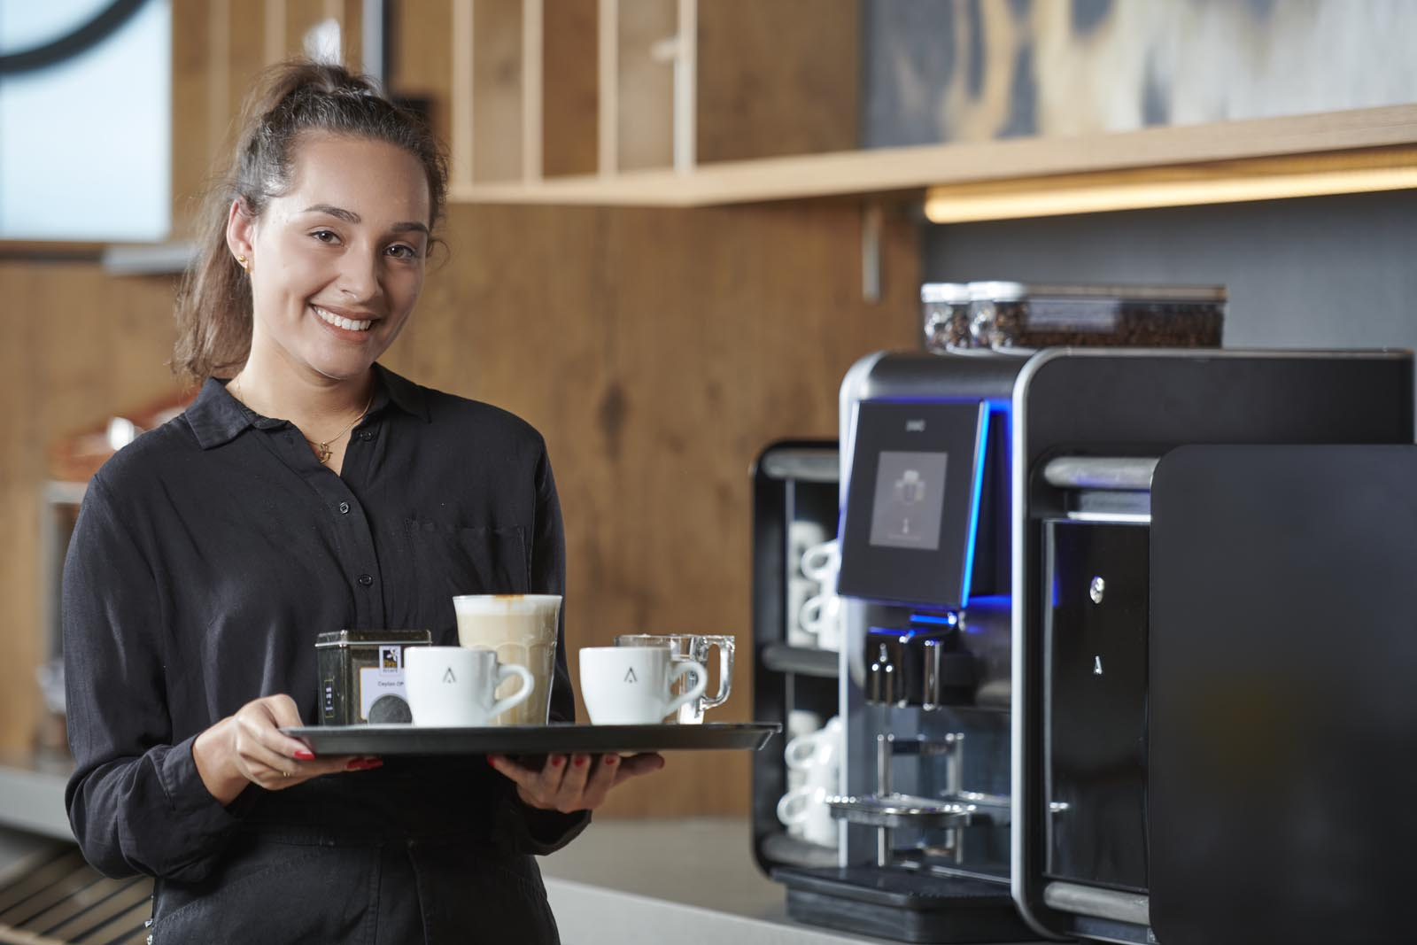
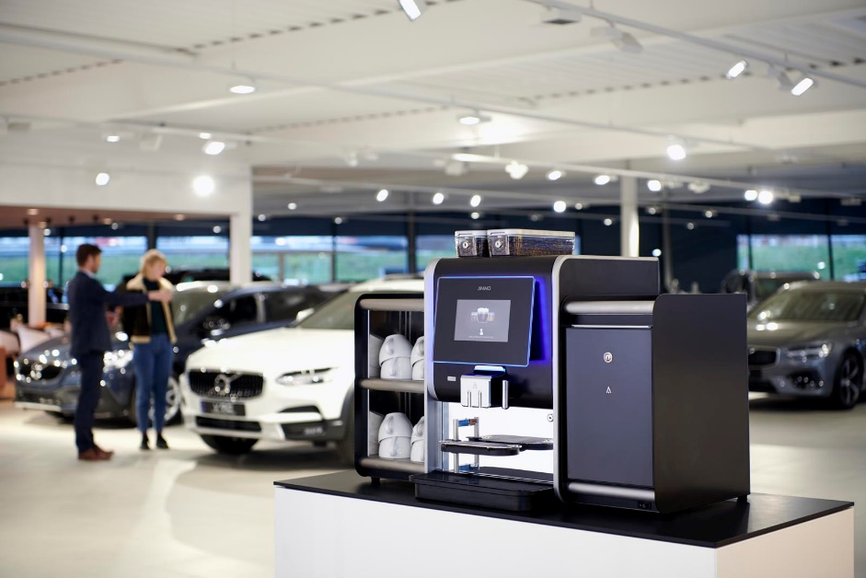
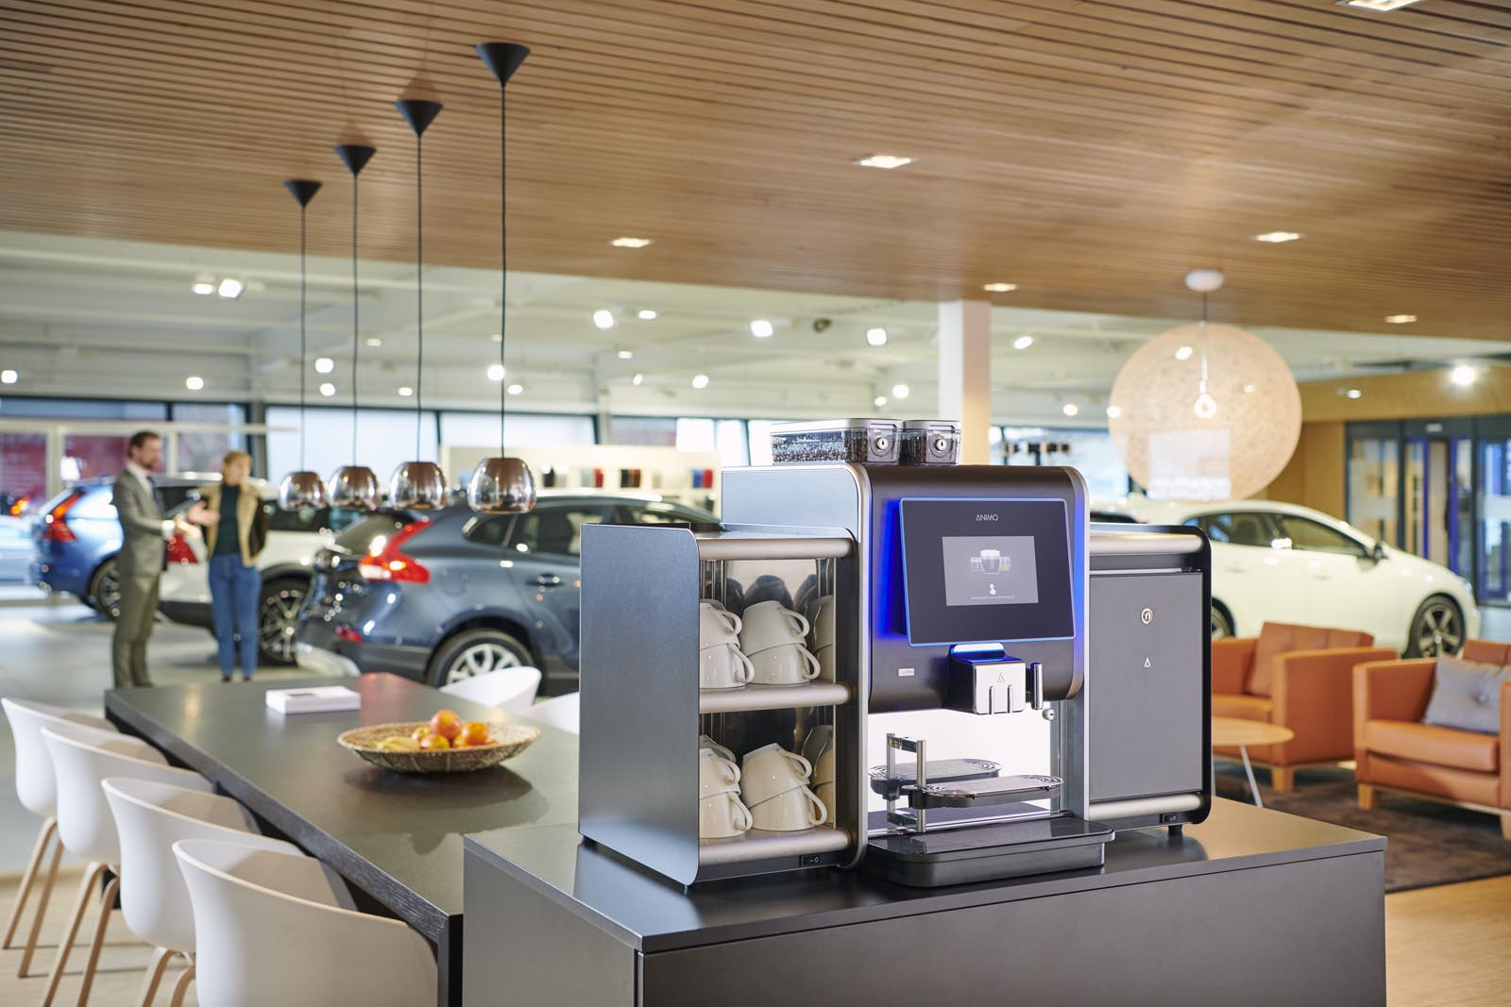
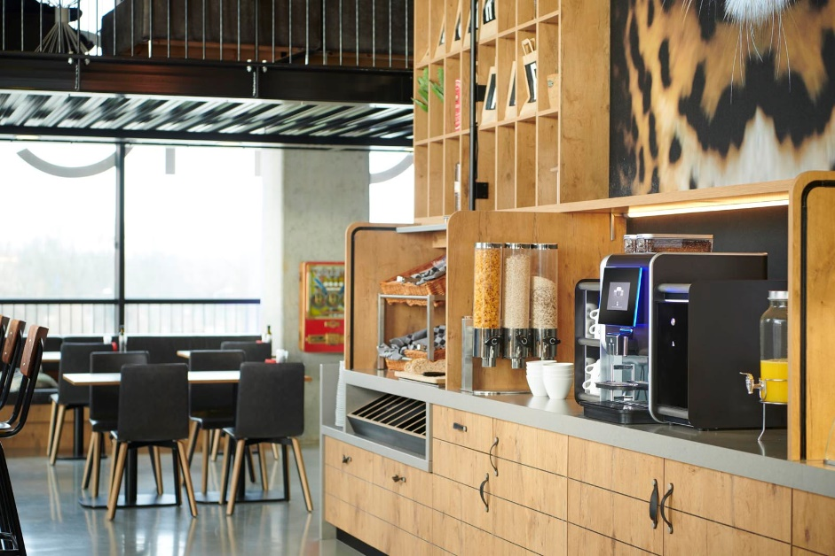
FITS EVERYWHERE

Slide 12
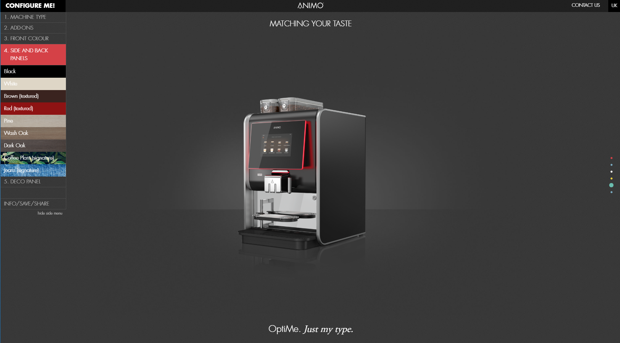
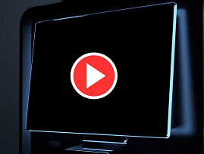
Design your
machine online

Slide 13
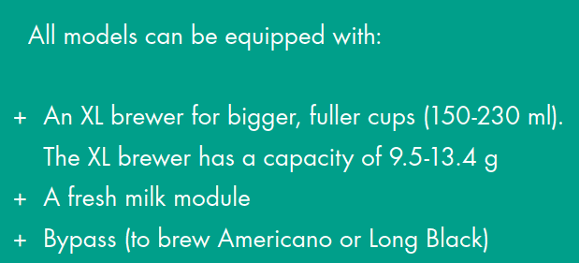
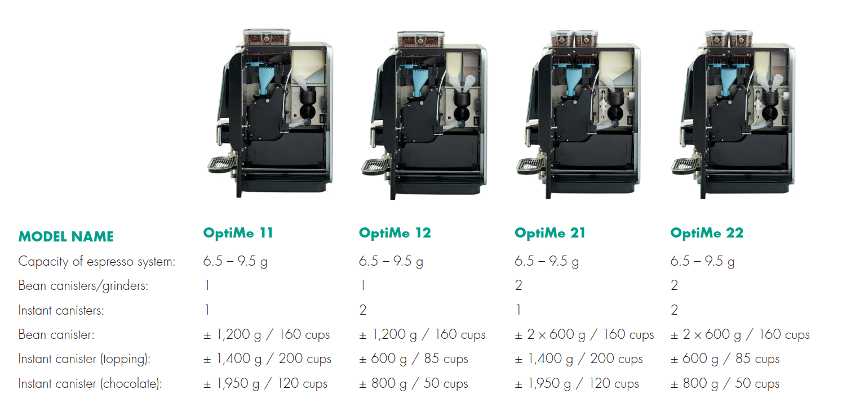
models

Slide 14
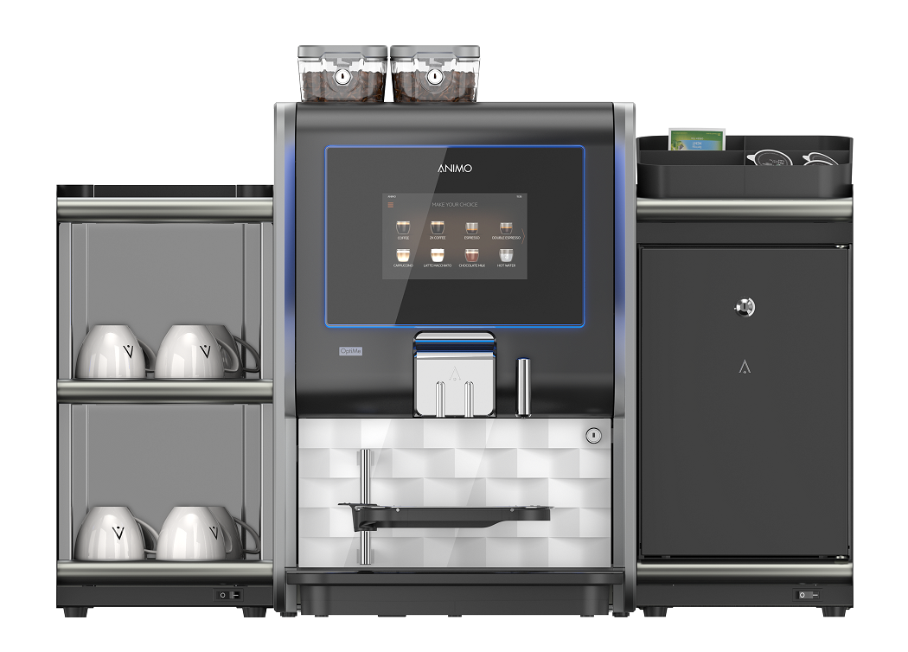
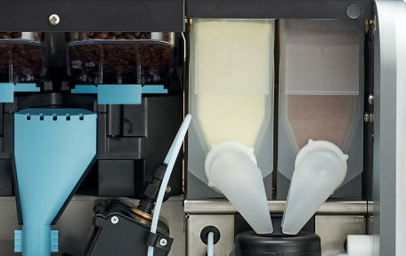
ADD-ONS
CUP WARMER
+ Add-on for all OptiMe models
+ Heated shelf floors: 3
+ Capacity (stacked): abt. 60 coffee cups / 144 espresso cups
+ Electrical connection: 220-240 V / 50-60 Hz / 105 W
+ Measurements (W × D × H): 230 × 420 × 455 mm
+ Weight: ± 11 kg
MILK COOLER WITH FRESH MILK SYSTEM
+ Add-on for all OptiMe models (always on right side)
+ Standard equipped with ingredient tray on top
+ Quick and easy cleaning (according HACCP standards)
+ Combined usage with topping possible
+ Milk pump in coffee machine; constant and perfect barista milk foam + Dispensing milk foam and hot or cold milk
+ Capacity milk: 4 l
+ Lockable door
+ Electrical connection: 220-240 V / 50-60 Hz / 43 W
+ Measurements (W × D × H): 230 × 420 × 455 mm
+ Weight: ± 19 kg
HOUSING FOR PAYMENT SYSTEMS
For coin mechanism (with or without exchanger) or contactless payment systems.

Slide 15
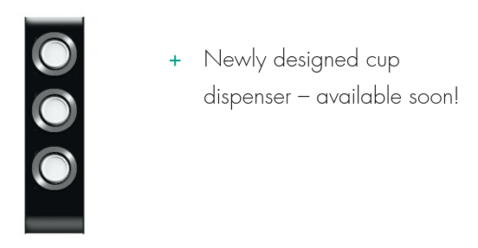
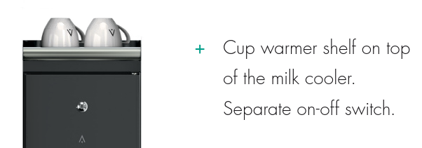
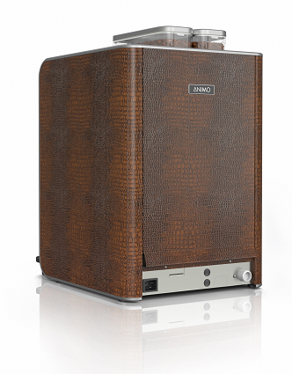
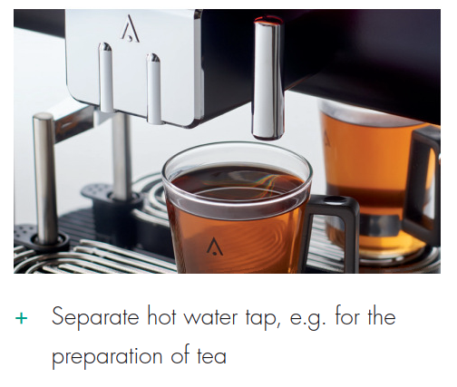
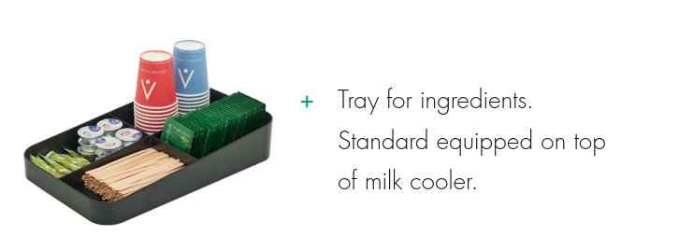
TECHNICAL SPECIFICATIONS
+ Brewing time, cup (120 ml): 25-30 sec.
+ Display: 7" touch screen
+ Adjustable cup tray: 50-105 mm
+ Max. tap height: 165 mm
+ Power supply: 220-240 V / 50-60 Hz / 2200 W
+ Water connection: ¾"
+ Waste canister volume: 3 l (± 70 cups)
+ Insulated stainless steel boiler (0.5 l) with 1800 W element and boil-dry protection
+ Measurements W × D × H: 380 × 515 × 600 mm + Weight: ± 32 kg
+ Signature editions

Slide 16
DEDICATED TO EVERY CUP

